Slide 1
Credit Card Opportunity Analysis for Mitron Bank
Insights from Pilot Project (4000 Customers, 5 Cities)
Presented by: Bhavani Maroju

Slide 2
Business Objective
Mitron Bank plans to launch a new line of credit cards.
The objective is to analyze customer spending behavior and identify target segments.
AtliQ Data Services proposed a pilot study using sample data to validate approach.
Sample data: 4000 customers across 5 cities.

Slide 3
Problem Statement / Project Scope
Identify key revenue and credit usage trends across customer segments.
Analyze customer profiles by age, city, gender, income, occupation.
Evaluate credit card penetration and utilization patterns.
Provide actionable recommendations to guide product strategy.

Slide 4
Solution Approach
There are 2 tables provided for analyzing customer behavior and tracking product strategy: a fact table (fact_spends) and a dimension table (dim_customers)
Data cleaning and modeling performed in Power BI.
Used multiple charts (bar, pie, KPI cards) to visualize:
Spend by category, payment type, age group
Monthly trends, city-level usage
Key KPIs calculated:
Average spend per customer
Utilization % per city and segment
Credit card usage count by age, city, and occupation

Slide 5
Key KPIs Summary
Total Customers: 4000
Male: 2597 | Female: 1403
Avg Spend per Customer: ₹88.48M / 4000 = ₹22,120
Utilization Rate: 42.82%
Sum of Avg Income: ₹207M
Married Customers: 3136 | Single: 864

Slide 6
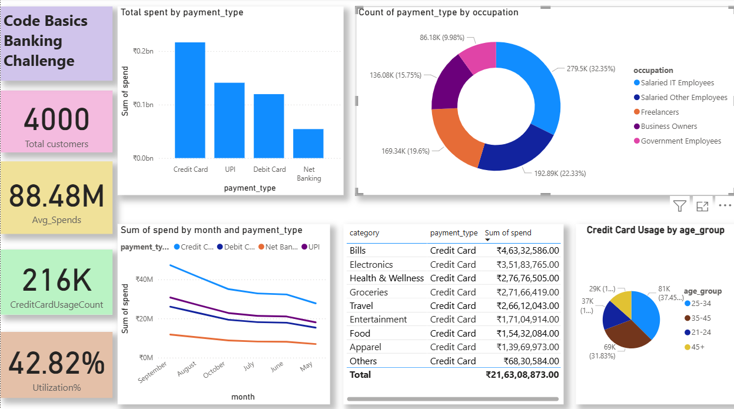
Dashboard

Slide 7
Key Insights
Mumbai has the highest credit card usage; Delhi has highest utilization rate.
Peak spend occurs in September and August.
25–34 age group contributes 37% of card usage.
Top Occupations: Salaried IT & Other Employees
Top spend categories: Groceries, Bills, Electronics.

Slide 8
Business Recommendations
Launch credit card in Mumbai, Chennai, Bengaluru (top usage cities).
Target age group 25–45 with lifestyle-focused offers.
Focus marketing on Bills, Grocery, Electronics partners.
Use August–September for promotional campaigns.
Design special card variants for salaried professionals.

Slide 9
Conclusion
This pilot analysis clearly shows how customer data can guide Mitron Bank's credit card strategy.
Key trends in age groups, cities, payment preferences, and spending behavior were identified.
The findings help pinpoint who to target, where to launch, and what features to offer.
With these insights, Mitron Bank can design smarter credit card products and improve adoption.

Slide 10
THANK YOU

